Slide 1


Stock Market Analysis
“The stock market is filled with individuals who know the price of everything, but the value of nothing.”

Slide 2





Meet The Group
Ganesh Nayak
Kritarth
Kshitiz Mangal
4NM21CS063
4NM21CS080
4NM21CS082

Slide 3


Stock Market
A STOCK MARKET OR SHARE MARKET IS THE COMBINATION OF BUYERS AND SELLERS OF STOCKS, WHICH REPRESENT THE OWNERSHIP OF THE BUSINESS

Slide 4

Stock Market Analysis
STOCK MARKET ANALYSIS IS A METHOD FOR INVESTORS AND TRADERS TO MAKE BUYING AND SELLING DECISIONS
STOCK PRICE ANALYSIS IS A POPULAR AND IMPORTANT TOPIC IN FINANCIAL AND ACADEMIC STUDIES
MANY METHODS LIKE TECHNICAL ANALYSIS, FUNDAMENTAL ANALYSIS, TIME SERIES ANALYSIS AND STATISTICAL ANALYSIS,ETC ARE ALL USED TO ATTEMPT TO PREDICT THE PRICE IN THE SHARE MARKET

Slide 5

Monitoring Stock Performance
Problem Statement
Comparing the performance of many stocks in a single visualization can be time consuming. It is particularly tedious if you want to do this over and over again. With the of R and Shiny, we can easily create and track a stock portfolio to see how individual stocks perform over time — all in one interactive visualization.

Slide 6
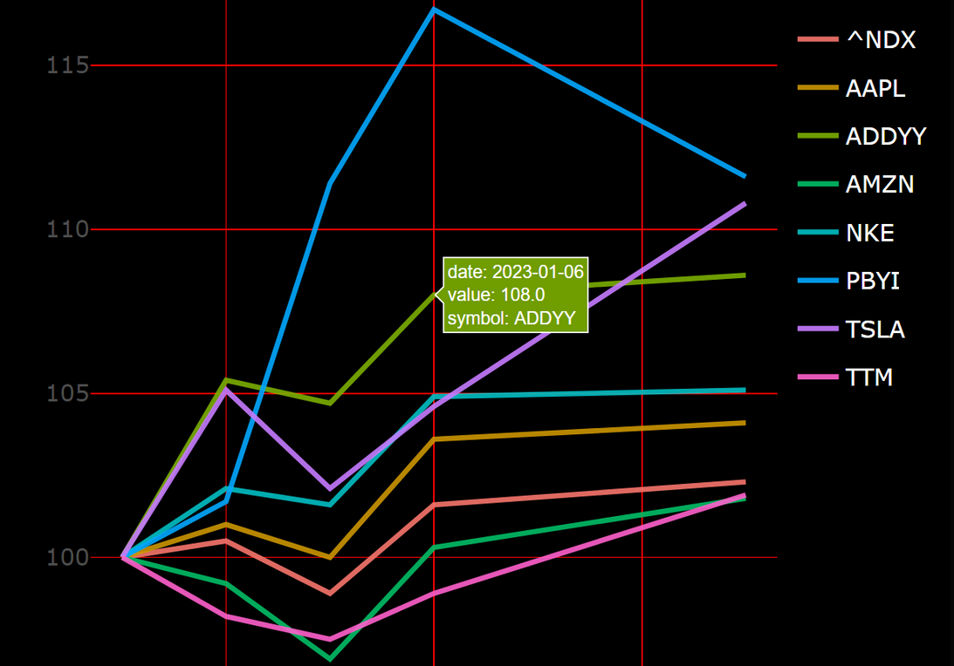
Project
Overview
To identify factors affecting the stock market.
To visualize a large set of data using graphs.
To predict an approximate value of the stock price.
To provide analysis for users through shiny web application.
To develop trading strategies that can help traders to improve their profit.

Slide 7



TOOLS USED
Applications used to create the application
R Programming
Yahoo finance
This is the building block of our project
This web site is used to retrive data.
R shiny app
This tool is used to create the web application

Slide 8




Research & Methodology
01
02
03
We gathered stock closing prices of Apple , Adidas, Amazon,Nike,Puma,Tesla and Tata Motors
We created a simple user interface using shiny web application which allows the user to select the data to be displayed
In the end we defined the server function.

Slide 9


Libraries Used
library(shiny)
library(shinyWidgets)
library(shinythemes)
library(plotly)
library(tidyverse)
library(tidyquant)

Slide 10

Collection of Data
tickers <- c("TSLA","AMZN","ADDYY","AAPL","TTM","NKE","PBYI")
benchmarks <- c("^NDX","^GSPC")
prices <- tq_get(tickers,
get = "stock.prices",
from = today()-months(12),
to = today(),
complete_cases = F) %>%
select(symbol,date,close)
bench <- tq_get(benchmarks,
get = "stock.prices",
from = today()-months(12),
to = today()) %>%
select(symbol,date,close)

Slide 11




UI DESIGN
Step 1
Giving option to select or deselect companies based on their choices on the side panel.
Step 2
Giving option to select time period on the side panel.
Step 3
Giving option to select a benchmark to compare to companies on the panel.

Slide 12
UI DESIGN
STEP 1 : TITLE PANEL & SIDEBAR
# Title
titlePanel("Stock Market Analysis"),
# Sidebar
sidebarLayout(
sidebarPanel(width = 3,
# Let user pick stocks
pickerInput(
inputId = "stocks",
label = h4("Stocks"),
choices = c(
"TESLA" = tickers[1],
"AMAZON" = tickers[2],
"ADDIDAS" = tickers[3],
"APPLE" = tickers[4],
"TATA MOTORS" = tickers[5],
"NIKE" = tickers[6],
"PUMA" = tickers[7]),
selected = tickers,
options = list(`actions-box`=TRUE),
multiple = T
),
# Pick time period
radioButtons("period", label = h4("Period"),
choices = list("1 month" = 1, "3 months" = 2,
"6 months" = 3,"12 months" =4,"YTD" = 5),selected =4),
# Pick benchmark
radioButtons("benchmark", label = h4("Benchmark"),
choices = list("SP500" = 1,"Nasdaq100"=2,"None" = 3),
selected = 3) )

Slide 13
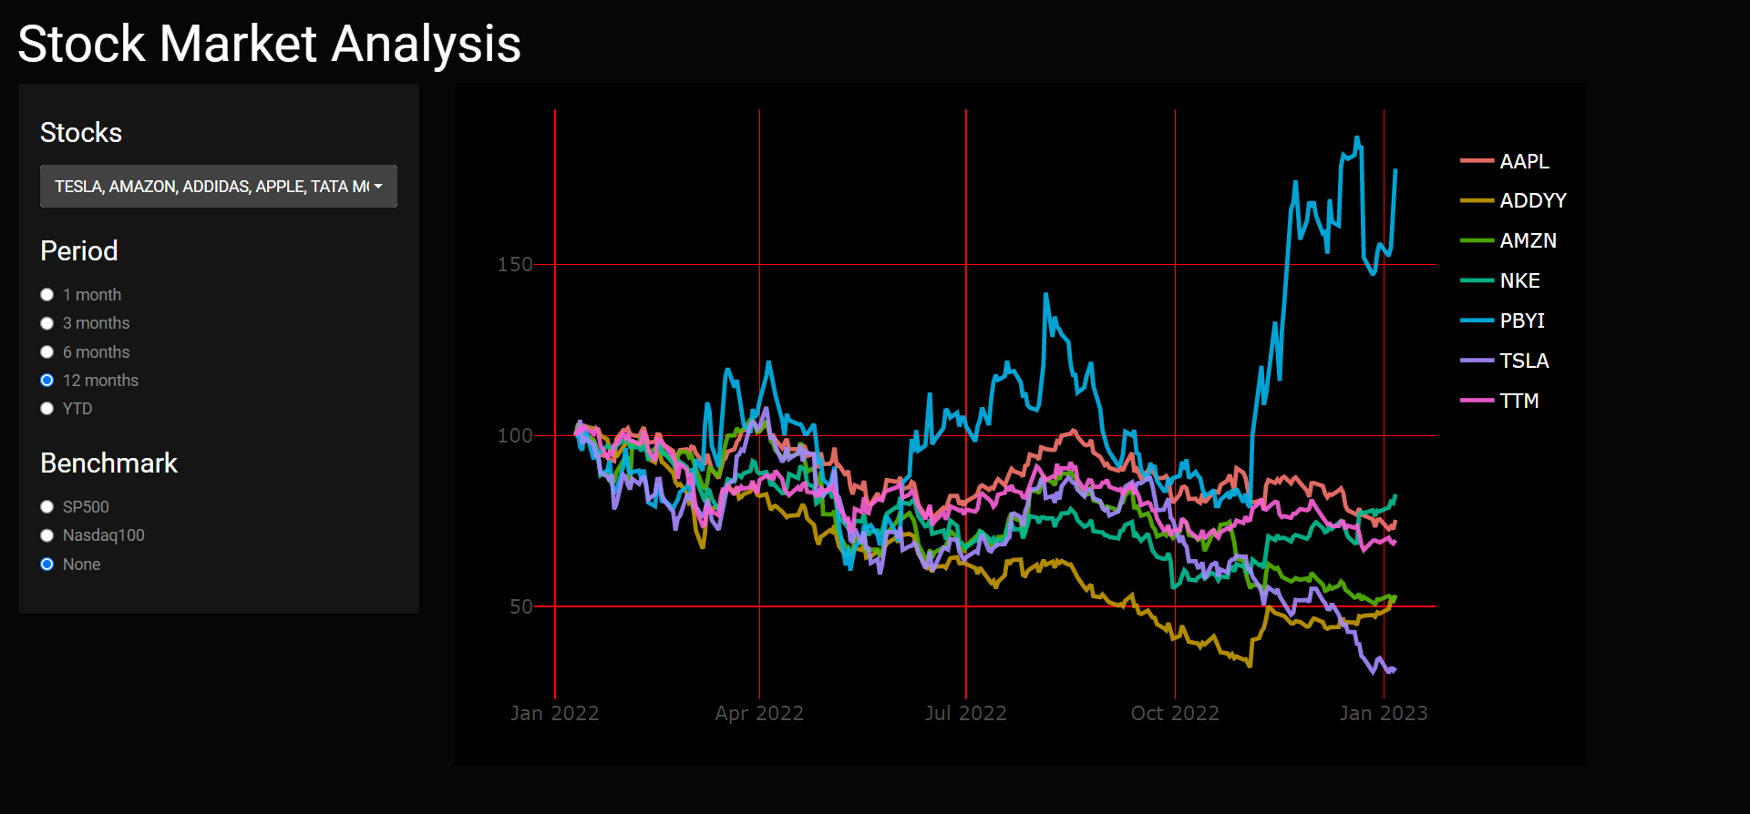
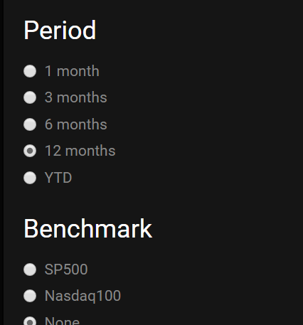
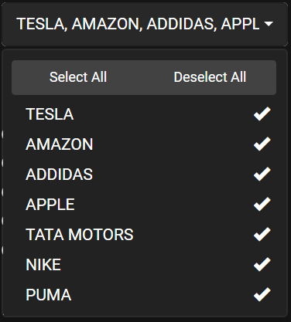

UI DESIGN
TITLE PANEL
RADIOBUTTONS
ACTION BOX

Slide 14

SERVER FUNCTION
if (input$period == 5) {
prices <- prices %>%
filter(year(date) == year(today())) }
if (input$benchmark == 1) {
bench <- bench %>%
filter(symbol=="^GSPC",
date >= min(prices$date))
prices <- rbind(prices,bench) }
if (input$benchmark == 2) {
bench <- bench %>%
filter(symbol=="^NDX",
date >= min(prices$date))
prices <- rbind(prices,bench) }
server <- function(input, output) {
# server logic based on user input
observeEvent(c(input$period,input$stocks,input$benchmark),
{
prices <- prices %>%
filter(symbol %in% input$stocks)
if (input$period == 1) {
prices <- prices %>%
filter(
date >= today()-months(1)) }
if (input$period == 2) {
prices <- prices %>%
filter(date >= today()-months(3)) }
if (input$period == 3) {
prices <- prices %>%
filter(date >= today()-months(6)) }

Slide 15

Output Plot
# uncomment the line below to show area under curves
#geom_area(aes(fill=symbol),position="identity",alpha=.2) +
theme_minimal(base_size=16) +
theme(axis.title=element_blank(),
plot.background = element_rect(fill = "black"),
panel.background = element_rect(fill="black"),
# panel.grid = element_blank())
panel.grid.major = element_line(color = "red", size = 0.5),panel.grid.minor = element_line(color = "red",size=0.5),
legend.text = element_text(colour="white"))
))})
# Create plot
output$plot <- renderPlotly({
print(ggplotly(prices %>%group_by(symbol) %>%
mutate(init_close=if_else(date== min(date),close,NA_real_)) %>%
mutate(value=round(100*close/sum(init_close,
na.rm=T),1)) %>%
ungroup() %>%
ggplot(aes(date, value,colour = symbol)) +
geom_line(size = 1, alpha = .9)+

Slide 16

CALLING THE SERVER
OUTPUT
# RUN THE APPLICATION
shinyApp(ui = ui, server=server)

Slide 17


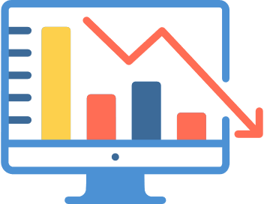
Conclusion
The project's goal was to create interactive visualizations to explore stock market data, the conclusion is that we achieved the visualizations and the value of the Shiny web application in facilitating data exploration.

Slide 18


Resources
1.) R Studio :RStudio integrates with R as an IDE to provide further functionality. RStdio combines a source code editor,bulid automation tools and a debugger.
2.) Shiny : Shiny is an R package that makes it easy to build interactive web apps straight from R.
3.) Yahoo Finance : It's the place for insight-driven investors, financial professionals and business leaders who take their money seriously.
Shiny
R Studio
https://shiny.rstudio.com
yahoo finance
https://finance.yahoo.com

Slide 19
Resources
Github
R Pubs
4.) GitHub :GitHub is a code hosting platform for version control and collaboration. It lets you and others work together on projects from anywhere.
5.) R Pubs : Rpubs is an open publishing platform for HTML documents produced using RMarkdown from within RStudio, it provides a simple way to host and share your presentations and documents. Documents stored on RPubs are available publically and allow other to comment on your content..
6.) Tutorials Point : Tutorials point is a dedicated website to provide quality online education in the domains of Computer Science, Information Technology, Programming Languages, and other Engineering as well as Management subjects.
https://shiny.rstudio.com
https://rpubs.com
Tutorials Point
https://tutorialpoint.com

Slide 20


